Slide 1
Data Flow Analysis
CSIE 5054: Advanced Compiler Design
Instructor: Shih-wei Liao

Slide 2

Register This Class
Basic Info Form
Notes:
透過編譯器，程式語言可以更抽象，簡化底層語言的認知...

Slide 3
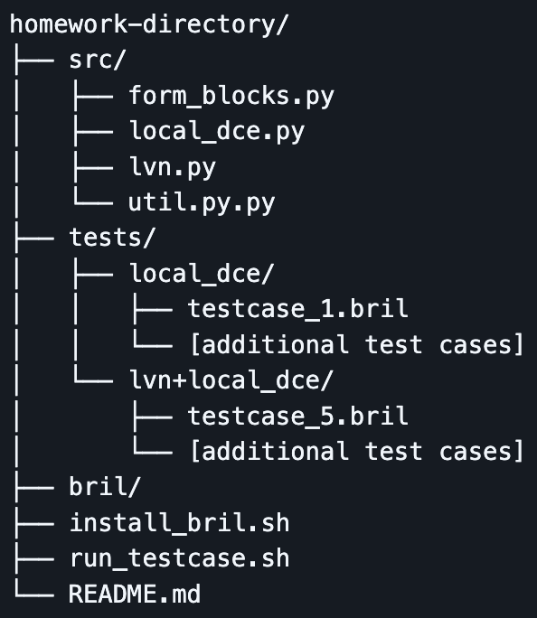
Homework 2: DCE and LVN for Bril
Goal: implement a local Dead Code Elimination (DCE) pass for the Bril intermediate representation (IR).
Set up environment
Bril toolchain(HW1)
Python3.7+
Implementation Tasks
DCE taught in class (local_dce.py)
DCE for Unused Reassignment (local_dce.py)
Validation

Slide 4
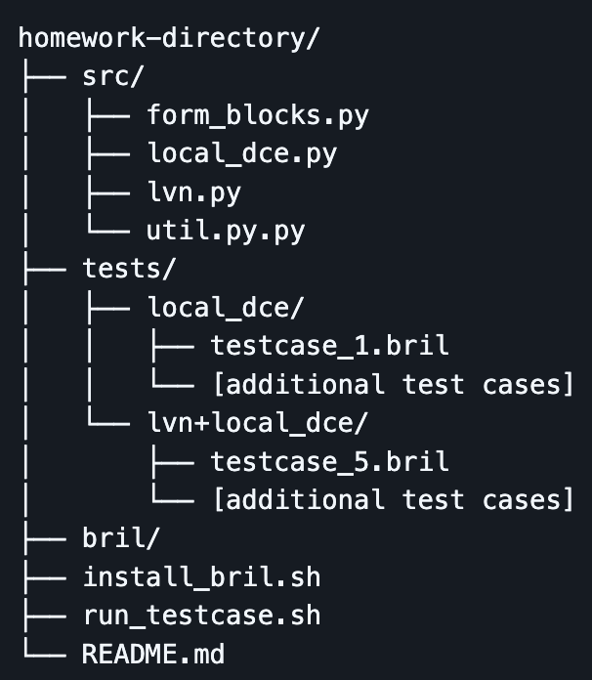
DOs and DONTs
Make sure a thorough understanding of the algorithm before starting
Correctness of the programs will be tested by TAs, testcases with invalid outputs gain 0 point.
Within /src directory, feel free to modify any files
Do NOT modify anything except for the above-mentioned files. Any such changes will be considered cheating.

Slide 5
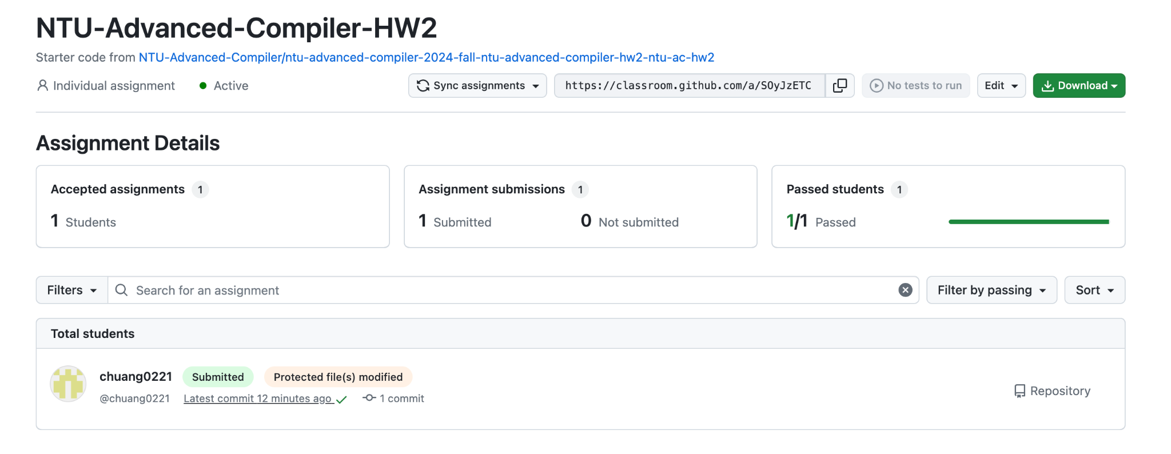
DOs and DONTs
Please note that we will be able to see through the GitHub Classroom backend if you have made changes to files that should not be modified.

Slide 6
Homework 2: DCE and LVN for Bril
Deadline: 2025/10/10 23:59
Homework 2 Specification
Homework 2 Github Repo
Basic Info Form

Slide 7
DOs and DONTs
Please stay away from idiotic plagiarism.
AI instead of TA will provide individual debugging support for coding.
Professor can do the class-level debug support.
If you have any questions relating to the homework, please consult LLMs first (chatGPT, Grok, Gemini).
If the questions are solvable by an LLM, that email will be subject to a score deduction.
If LLMs can’t solve it, please email to llvm@csie.ntu.edu.tw with the subject line '[AC-HW2][Summary of Your Issue]'

Slide 8
Table of Contents
Introduction to Optimization
Different Granularities of Optimization
Data-flow Problem
Liveness: Backward Data-flow Problem
Dominance: Forward Data-flow Problem
Global Optimization with Data-flow Analysis
Data-flow Analysis Framework
Lattice Theory
Notes:
P406

Slide 9
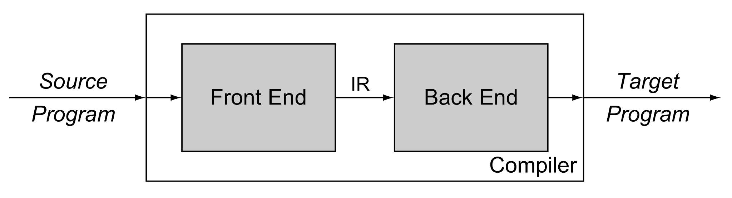
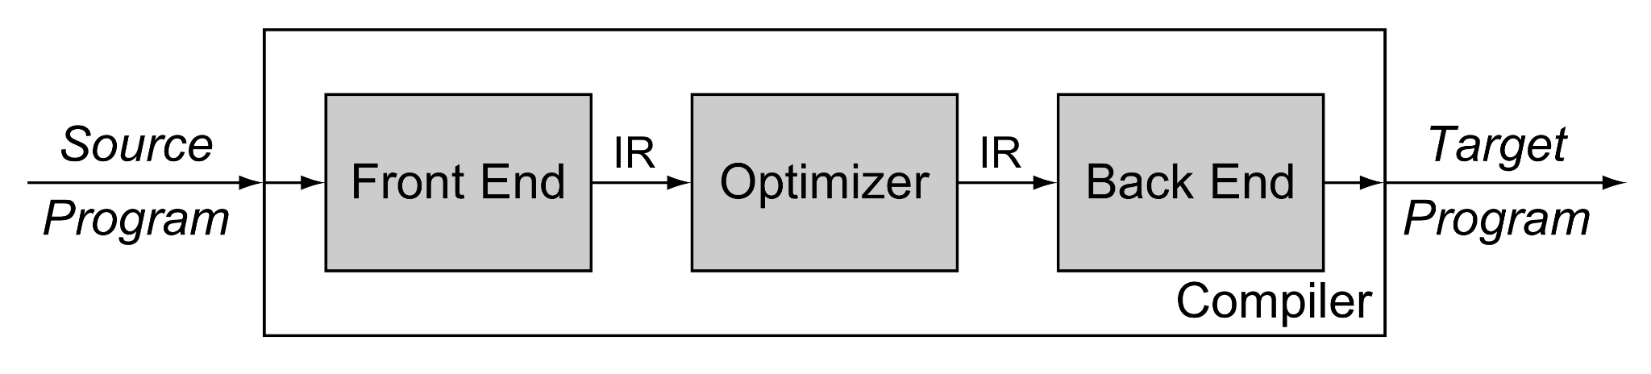
Why we Need Optimization in Compiler
Notes:
P406

Slide 10
Why we need Optimizations in Compiler
Simpilify the task of intermediate representation (IR) generation in the front-end.
Improve the quality of the code generated by the back-end.
Bridge the gap between processor speed and application performance.
Notes:
P406

Slide 11
Different Objectives for Designing the Optimizer
Runtime speed
Code size
Register use
Memory use
Energy Consumption
Number of Page Faults
Notes:
P407

Slide 12
Two Considerations for Optimization
Safety
After applying the IR transformation, it preserves the program’s meaning.
Profitablility
After applying the IR transformation, it improves the program’s performance.

Slide 13
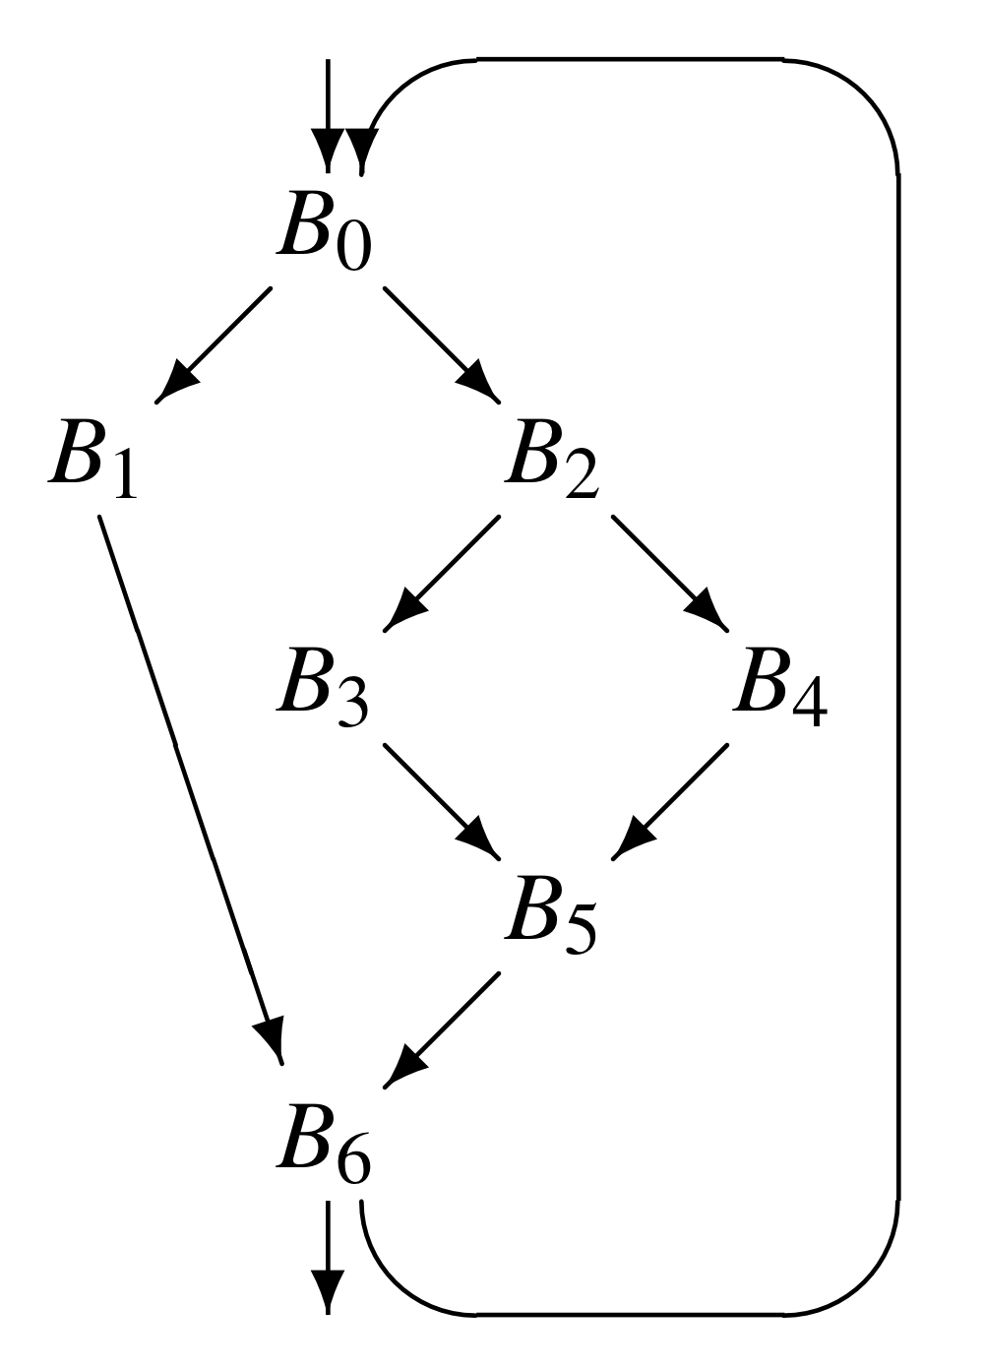
Different Granularities of Optimization
Local Methods: Operate over a single basic block.
Operate on the three-address code.
Regional Methods: Operate over scopes larger than a single basic block but smaller than a full procedure.
Operate on the control-flow graph (CFG).
For example, the compiler might consider the entire loop as a single region.
Notes:
Different scopes of optimizations provide different opportunities to othe optimizer… metion a example on a invariant variable in the for loop.

Slide 14
Different Granularities of Optimization
Global Methods: Operate over an entire procedure.
Operate on the control-flow graph.
Decisions that are locally optimal may have bad consequences in some larger context.
Whole-program Methods: Operate over the entire program.
Operate on the program’s call graph.
Notes:
Please read EAC 2ed p419 for a more detailed discussion about why choosing the terms instead of intraprocedural vs. interprocedural.

Slide 15
Global Optimization
Optimizations that examine an entire procedure have opportunities for improvement that are not available at smaller scopes.
Because the scope includes cyclic paths and backward branches, global optimization need global analysis.
Global optimization consists of two phases:
Analysis phase
Transformation phase

Slide 16
What’s the Data-flow Analysis
Local Analysis
Analyze effect of each instruction
Compose effects of instructions to derive information from beginning of basic block to each instruction
Data-flow Analysis
Analyze effect of each basic block
Compose effects of basic blocks to derive information at basic block boundaries

Slide 17
What’s the Data-flow Analysis
Data-flow analysis takes the IR as input and decides whether or not they have a certain property.
Rice’s theorem states that all interesting questions about the input/output behavior of programs are undecidable.
While it’s impossible to build an analysis that would correctly decide a property for any analyzed program, it is often possible to build analysis tools that give useful answers for most realistic programs.
Notes:
Rice’s theorem, non-trivial semantic properties are undecidable

Slide 18
What’s the Data-flow Analysis
The approximative properties of the program can help us generate efficient code:
Does the program contain dead code? If so, the code size can be reduced.
Is the value of some expression inside a loop the same in every iteration? If so, the expression can be moved outside the loop.
Does the value of variable x depend on the program input? If not, it could be precomputed at compile time.
……

Slide 19
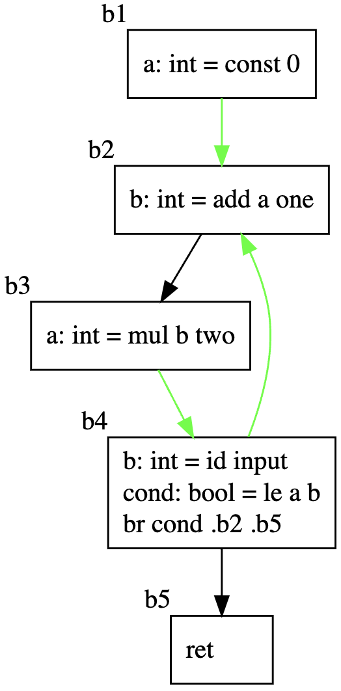
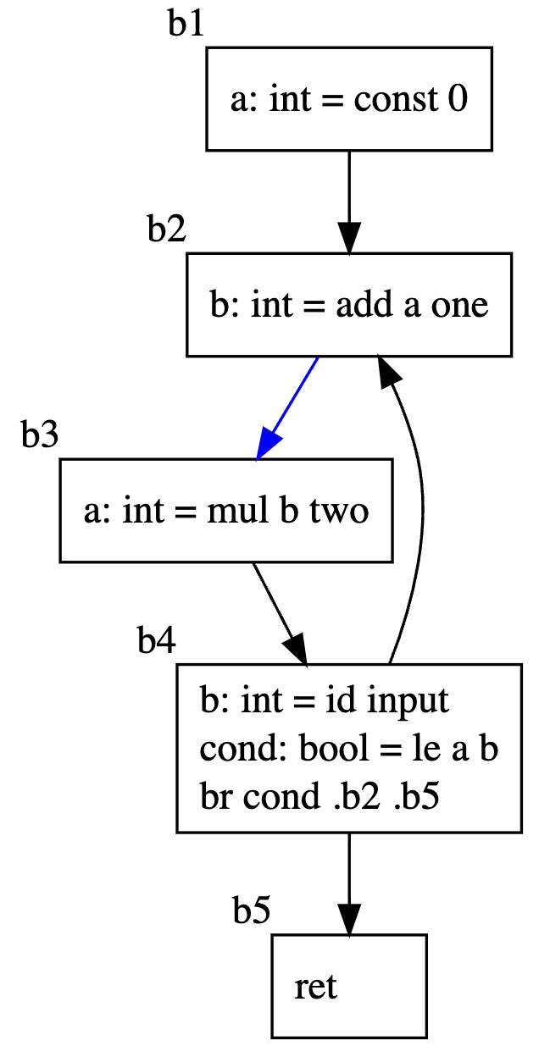
An Example of Data-flow Analysis: Liveness
Definition
A variable v is live at point p if
the value of v is used along some path in the flow graph starting at p.
Otherwise, the variable v is dead.
The green and blue arrows stand for the liveness of a and b respectively.

Slide 20
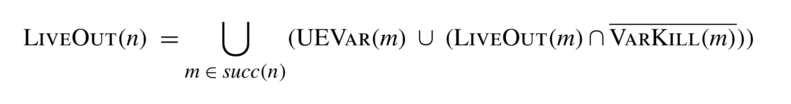
Data-flow Equation of Liveness
A variable is live on exit from a node if it is live on the entry to any successor node.
A variable is live on entry to the node if:
it is used by the node
it is live on exit from the node and the node does not redefine the value of the variable

Slide 21
Data-flow Equation of Liveness
LIVEOUT(n): The variables that are live at the end of the block n.
UEVAR(m): The variables that are used in block m before any redefinition in block m, that is, upward-exposed variables.
VARKILL(m): The variables that are defined in block m.

Slide 22
Solving the Data-flow Problem
Compiler can use a three-step algorithm to compute the LIVEOUT
Build a Control-flow Graph
Gather initial information: The analyzer computes a UEVAR and VARKILL set for each block b in a simple walk
Solve the equations to produce LIVEOUT(b) for each block b: Use the iterative fixed-point algorithm to solve the equations

Slide 23
Recap: Basic Blocks & Control-flow Graph
Basic block: a sequence of 3-address statements.
Only the first statement can be reached from outside the block. (no branches into middle of block)
All the statements are executed consecutively if the first one is. (no branches out or halts except perhaps at end of block)
We require basic blocks to be maximal, i.e., they cannot be made larger without violating the conditions.

Slide 24
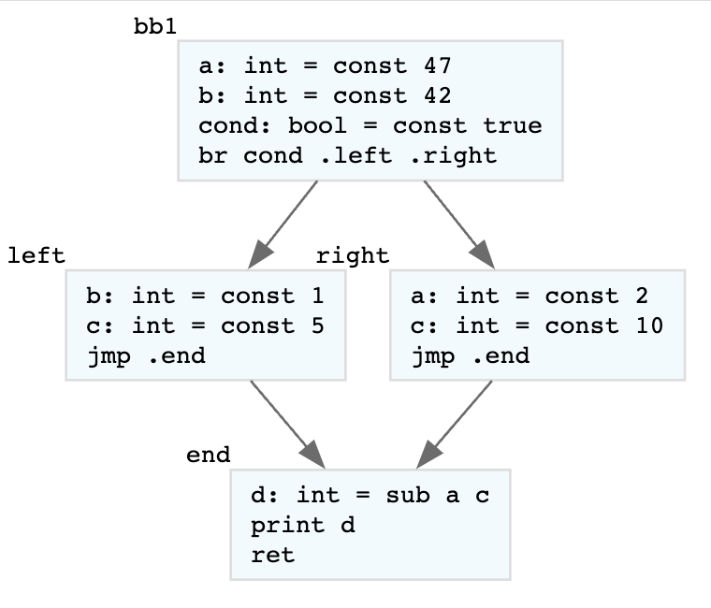
Recap: Basic Blocks & Control-flow Graph
Control Flow Graph (CFG):
Nodes: Basic Blocks
Edges: possible transfer from a Basic Block to another

Slide 25
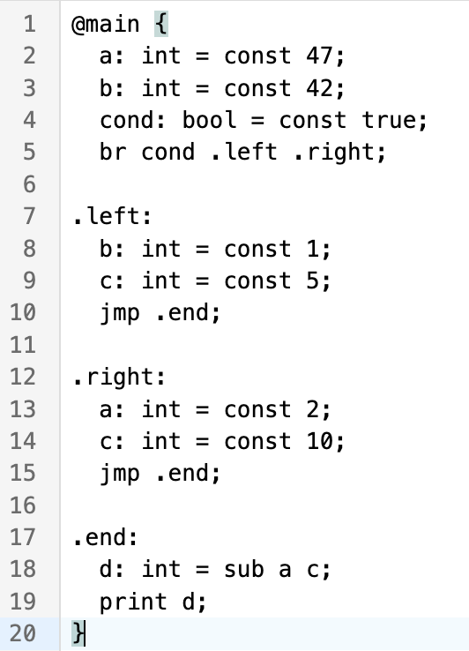
Building a Control-flow Graph from a Linear IR
Separate the list of instructions into basic blocks

Slide 26
Building a Control-flow Graph from a Linear IR
Form the control-flow graph from the basic blocks.

Slide 27
Basic Blocks Forming Alogrithm
Input: List of instructions
Output: List of lists of instructions
Identify the leader of each basic blocks
First Instruction
Any target of a jump
Any instruction immediately following a jump
Basic block starts at leader & ends at instruction immediately before a leader (or the last instruction)

Slide 28
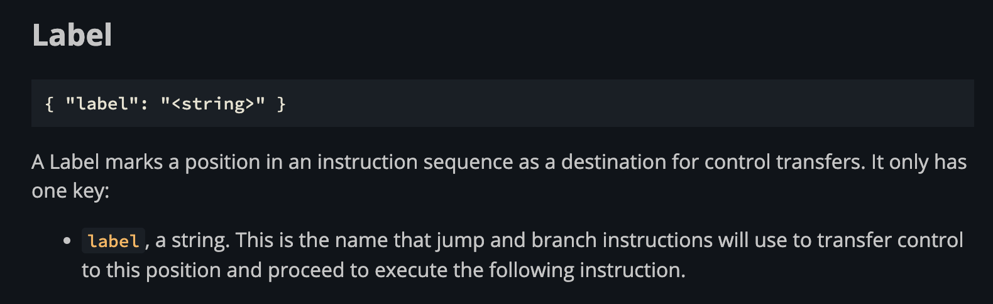
Basic Blocks Forming Alogrithm
Take Bril’s program as example:
Identify the leader of each basic blocks:

Slide 29
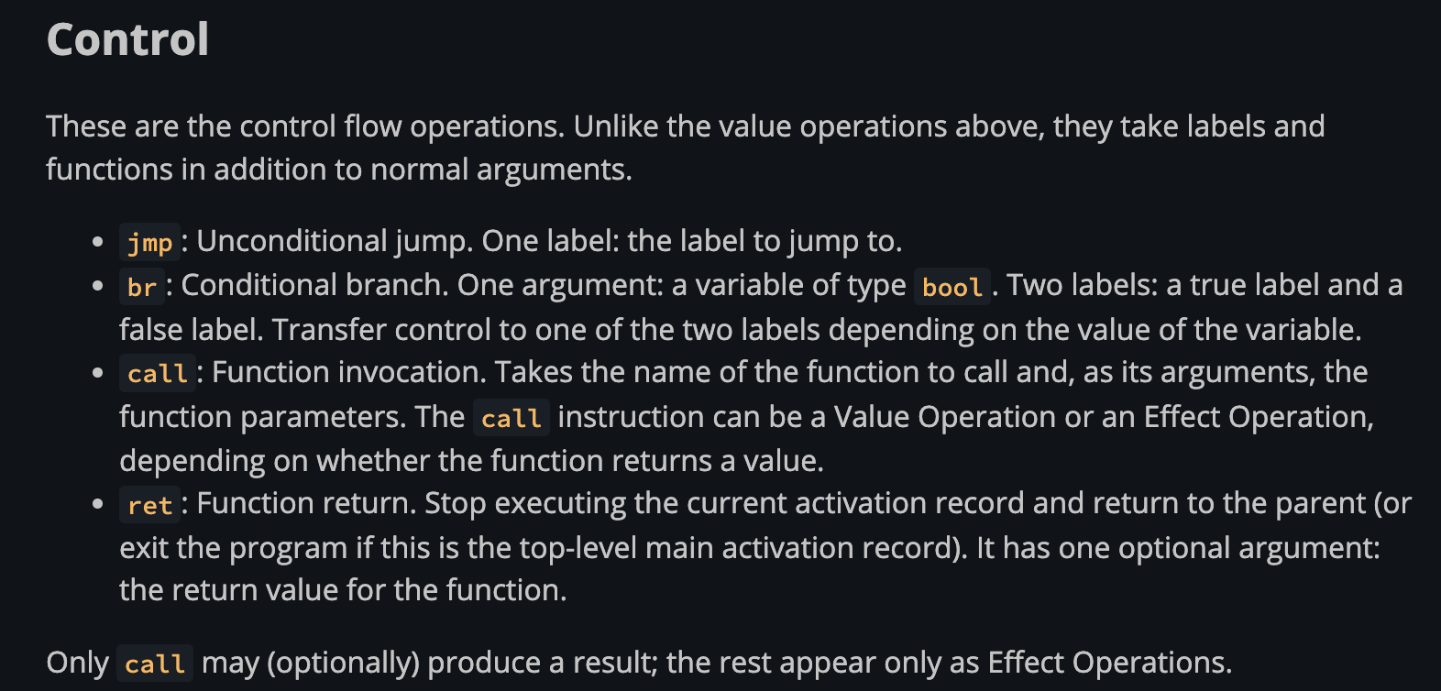
Basic Blocks Forming Alogrithm
Take Bril’s program as example:
Identify the ends of each basic blocks (terminators):

Slide 30
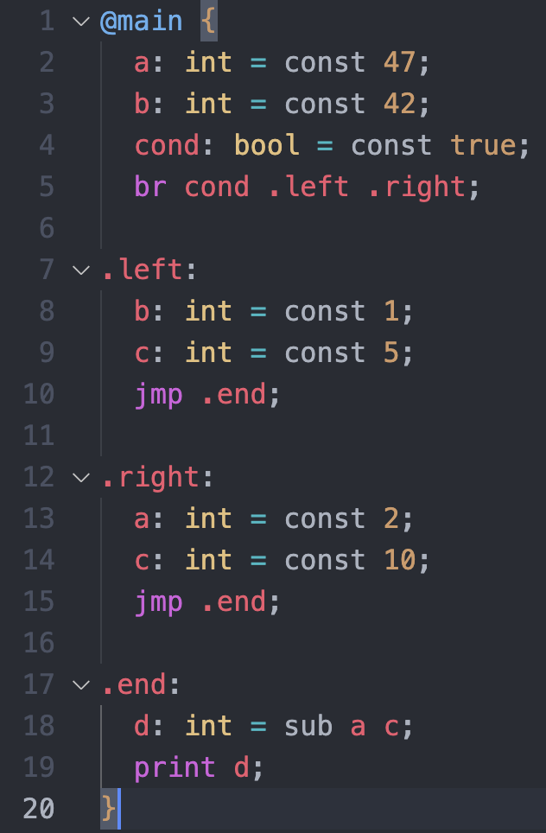
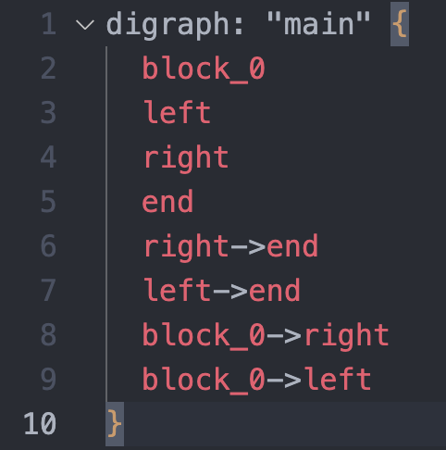
Control-flow Graph Forming Alogrithm
Input: List of lists of instructions
Output: Dictionary to store the label to the list of labels

Slide 31
Control-flow Graph Forming Alogrithm
Store the label names onto the corresponding basic blocks.
For each basic block:
Check whether the last instruction of the block is a terminator.
If it’s a terminator and a jump instruction, add an edge from the block to the destination block.
If it's a terminator and it's a branch instruction, add edges from the block to all of the possible blocks.
If it's not a terminator, if there exists a next-coming block, add an edge from this block to the next-coming block.
Notes:
iii?

Slide 32
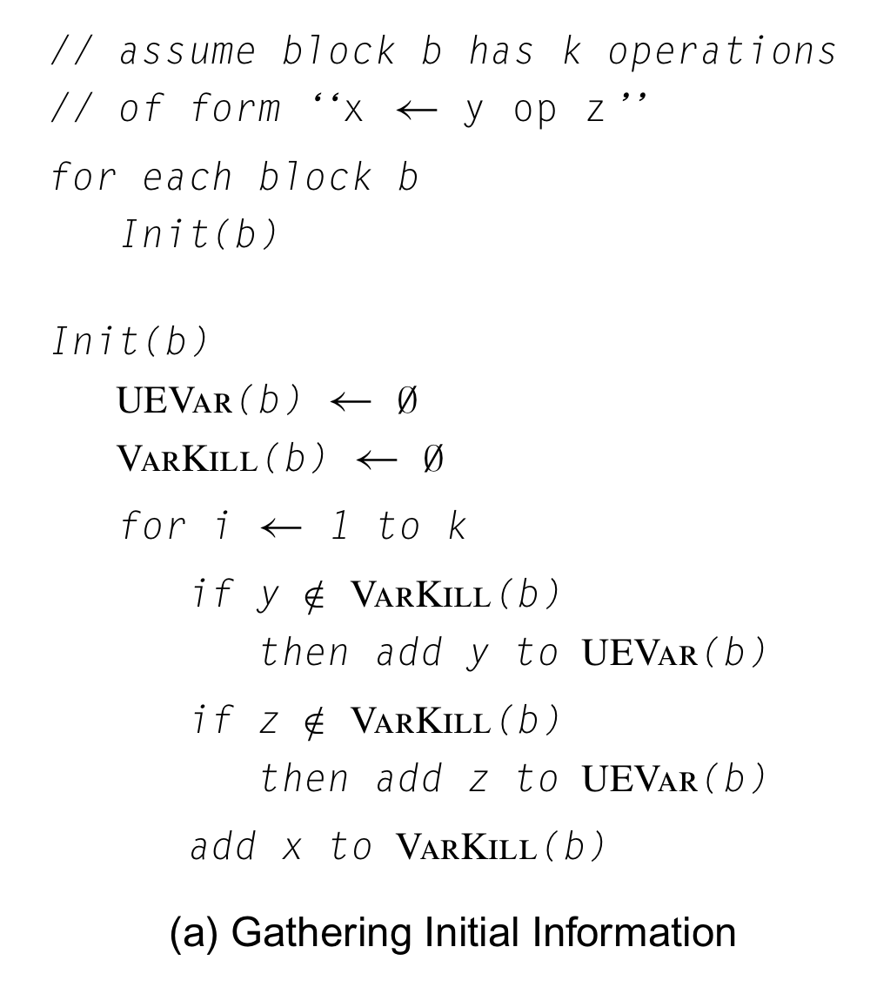
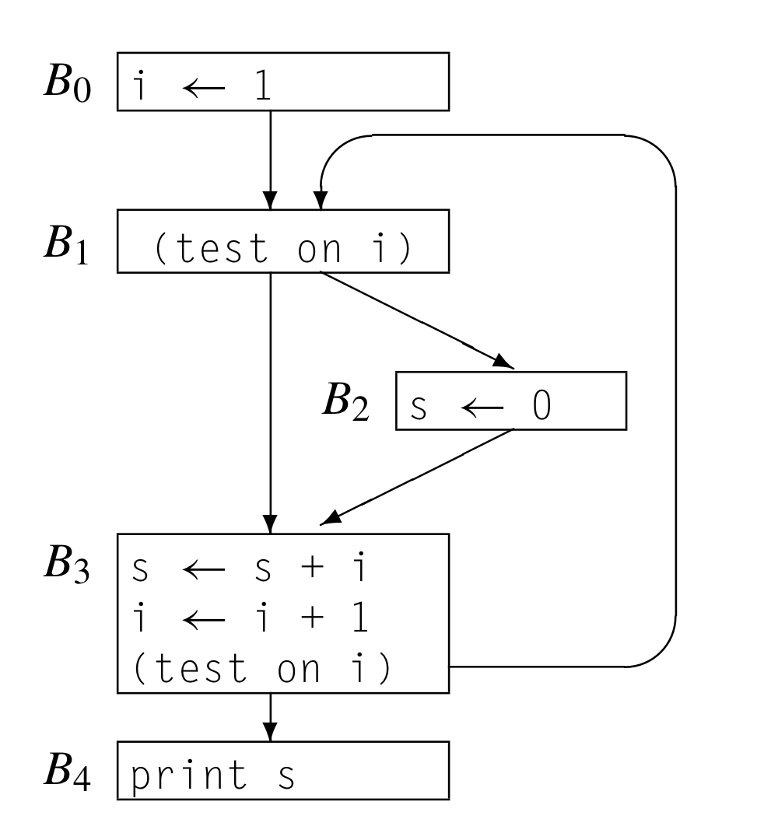
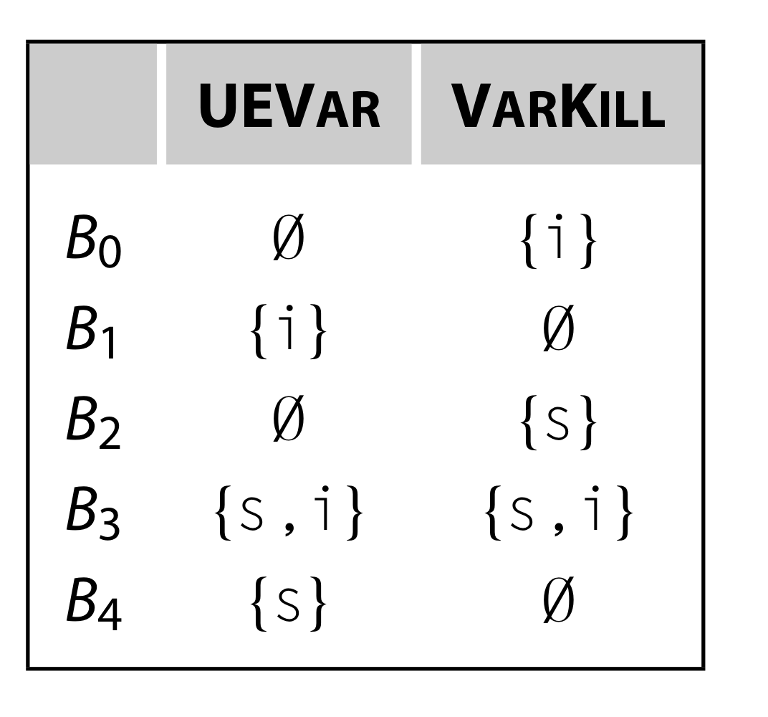
Gather Initial Information

Slide 33
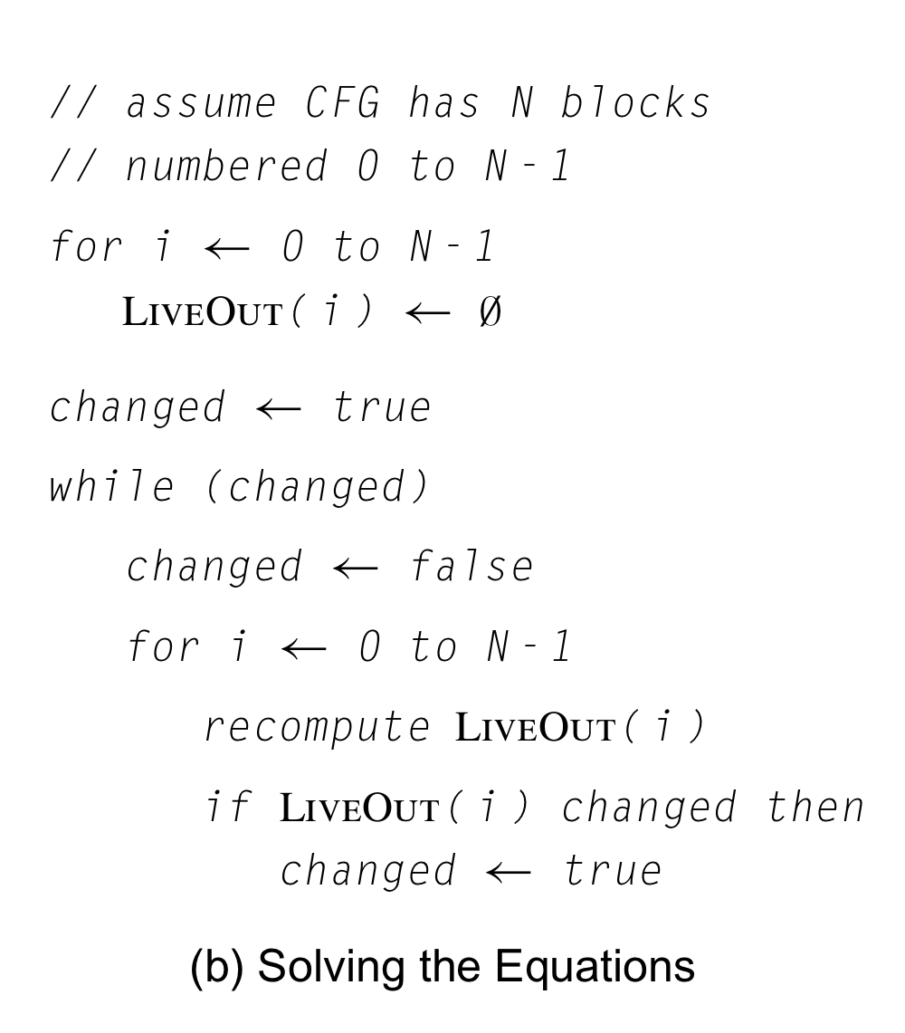
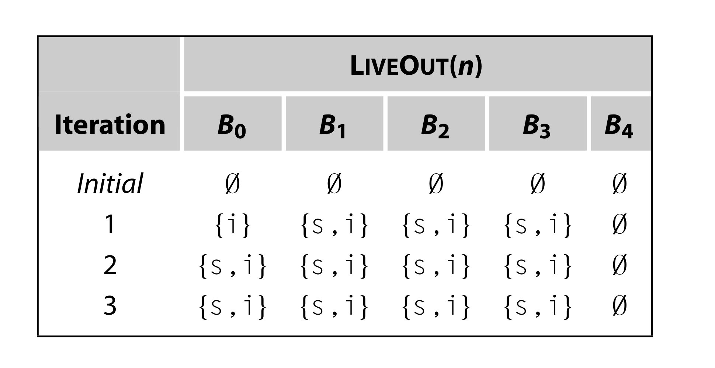
Iterative Fixed-point Algorithm

Slide 34
Worklist Algorithm
Worklist Algorithm is an alternative to Iterative Fixed-point Algorithm.
Maintain a FIFO queue called the worklist to keep track of nodes whose data-flow equations might not satisfied at any given step.
Initialize the worklist to contain all nodes.
While the worklist contains some node n:
Remove node n from the worklist
Compute the LIVEOUT(n) using the data-flow equation.
If LIVEOUT(n) changed, push all predecessors of n onto the worklist.

Slide 35
Termination, Correctness, and Efficiency
Termination: Does the iterative fixed-point algorithm halt?
Correctness: Does the iterative fixed-point algorithm produce the correct LIVEOUT sets?
Efficiency: How fast is the iterative fixed-point algorithm?

Slide 36
Termination
The finite descending chain property will guarantees termination and the termination independent of the evaluation order.
Finite descending chain property:
Monotonicity: In the while loop of the algorithm, the LIVEOUT sets grow monotonically.
Finite number of possible values for the underlying sets: The size of any LIVEOUT set is bounded by the number of variables.
In the worst case, one LIVEOUT set would grow by one element in each iteration; that behavior would halt after n * |V| iterations.

Slide 37
Correctness
Iterative fixed-point algorithm is correct iff it finds all the variables that satisfy the definition of liveness at the end of each block.
To form LIVEOUT(n), the iterative solver computes the contribution to LIVEOUT(n) of each successor of n in the CFG.
A variable v is live at point p iff there is a path from p to a use of v along which v is not redefined.
Liveness is defined in terms of paths in the CFG.
How dose this local computation over individual edges relate to liveness defined over all paths?

Slide 38
Correctness
The theory of iterative data-flow analysis assures us that the fixed-point is unique.
The uniqueness of the fixed point guarantees that the fixed-point solution computed by iterative algorithms is identical to the meet-over-all-paths solution called for by the definition.

Slide 39
Efficiency
Since the fixed-point solution is unique, the analyzer can choose any order of evaluation in fixed-point algorithm.
The analyzer should choose the one that produces rapid termination.
Forward & backward data-flow problem:
Forward data-flow problem: In the data-flow equation, the information is flowing forward along the arrows in the CFG, e.g., DOM.
Backward data-flow problem: In the data-flow equation, the information is flowing backward along the arrows in the CFG, e.g., LIVEOUT.

Slide 40
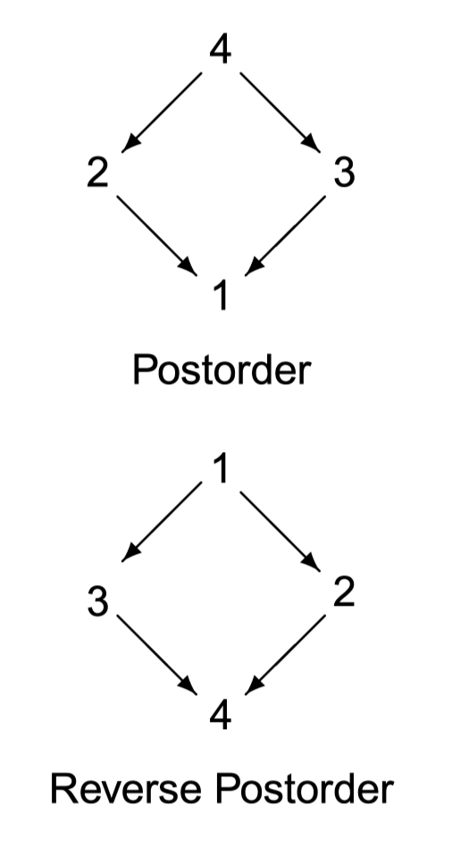
Efficiency
For most forward data-flow problems, the reverse postorder produces the rapid termination.
For most backward data-flow problems, the reverse postorder on the reverse CFG produces the rapid termination.
These orders force the iterative algorithm to evaluate as many predecessors or successors as possible before it evaluates a node n.

Slide 41
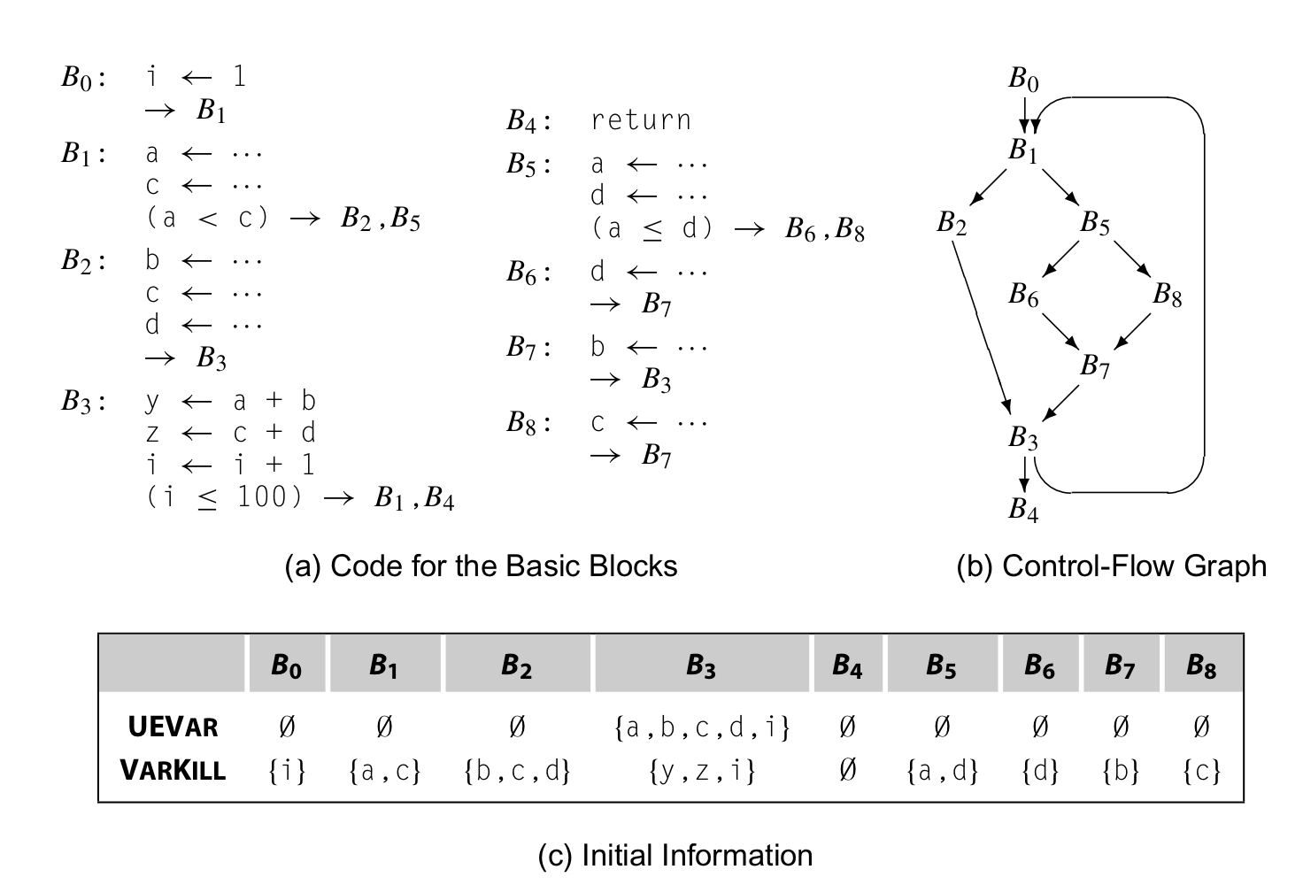
Efficiency

Slide 42
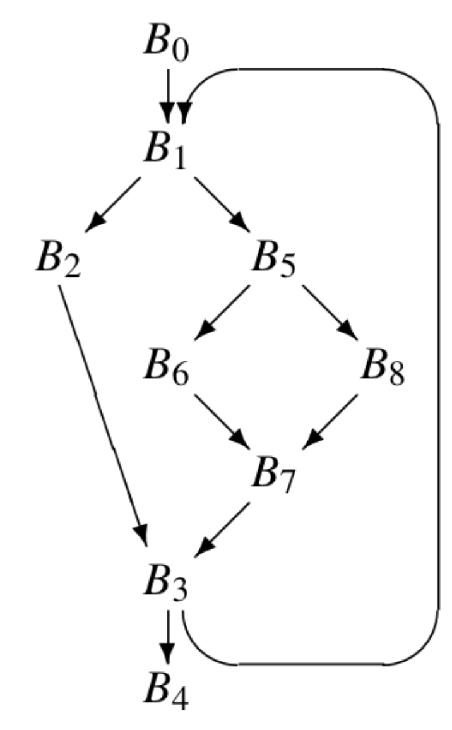
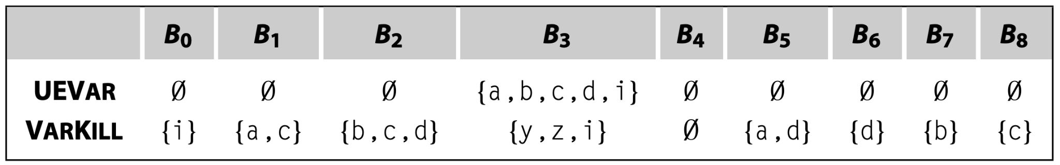
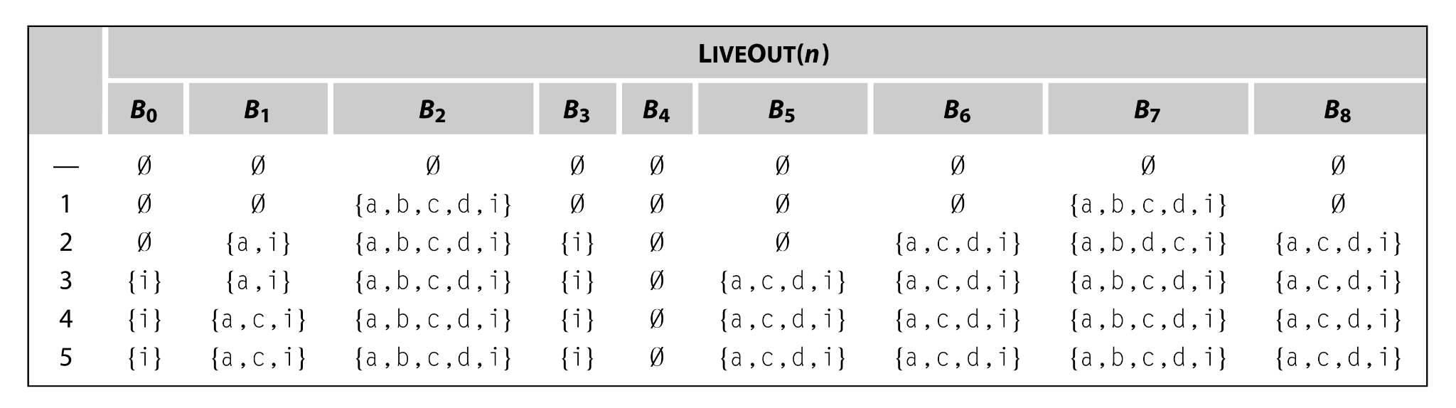
Efficiency
Evaluate using the order: B0, B1, B5, B8, B6, B7, B2, B3, B4

Slide 43
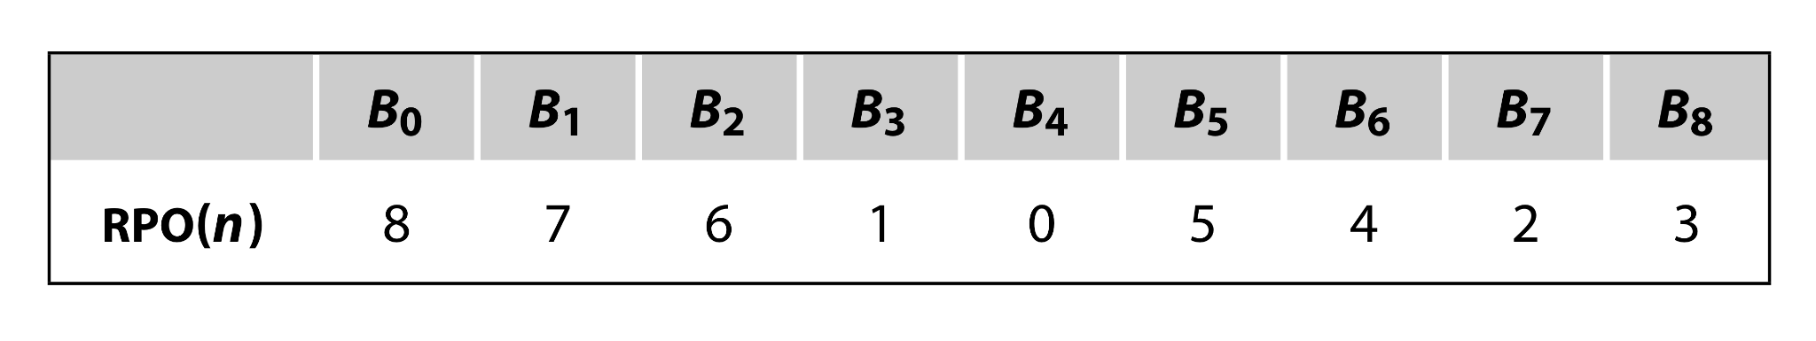
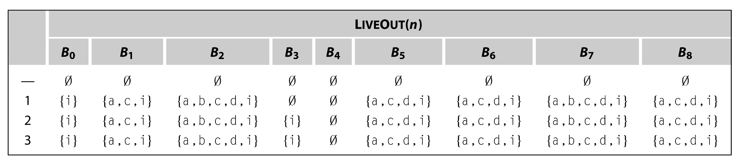
Efficiency
Evaluate the nodes in the the reverse postorder on the reverse CFG:
Notes:
TODO: think thru the order
outputs of Reverse postorder RLN and reverse of postorder (LRN) are not the same, here referred to reverse of postorder the rev of rev is not the same as postorder of (G) link

Slide 44
Global Optimization with Liveness
We can find potential uses of uninitalized variables by computing information about liveness.
Uninitialized variables: If a procedure p can use the value of some variable v before v has been assigned a value, we say that v is uninitialized at that use.
Given a LIVEOUT set for the CFG’s entry node n, each variable in LIVEOUT(n) has a potentially uninitialized use.

Slide 45
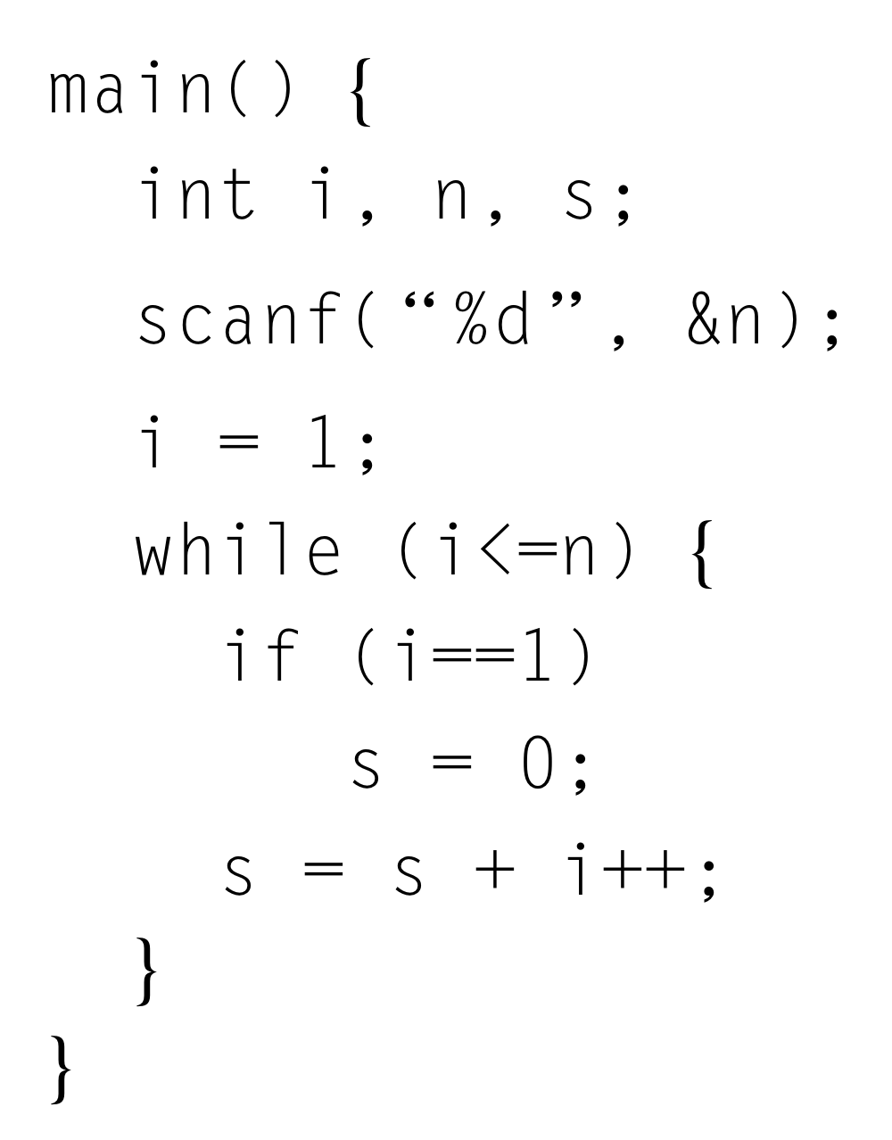
Limitations in Data-flow Analysis
Data-flow analysis is conservative: Data-flow analysis accounts for the effects along all possible paths through the code.
For example, finding the uninitialized variables with the live information may cause the false positive in the case.
Notes:
One possible path is the use of s in while loop bypass any other bb to the first bb, s.t., the liveout(bb1) has s, which is not init.

Slide 46
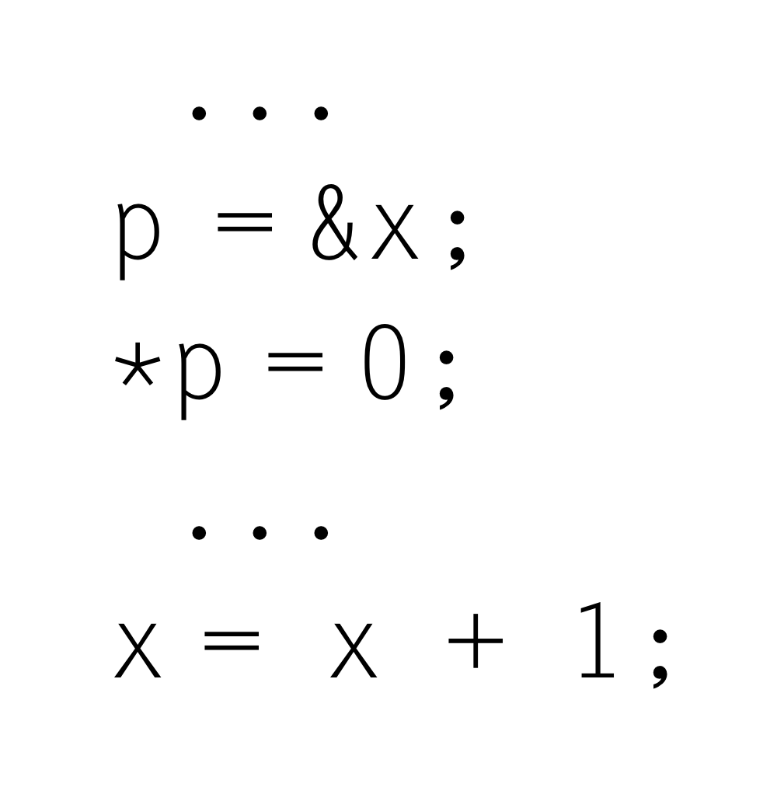
Limitations in Data-flow Analysis
Troublesome when dealing with indirect access: If v is accessible through another name and initialized through that name, live analysis will not connect the initialization and the use.

Slide 47
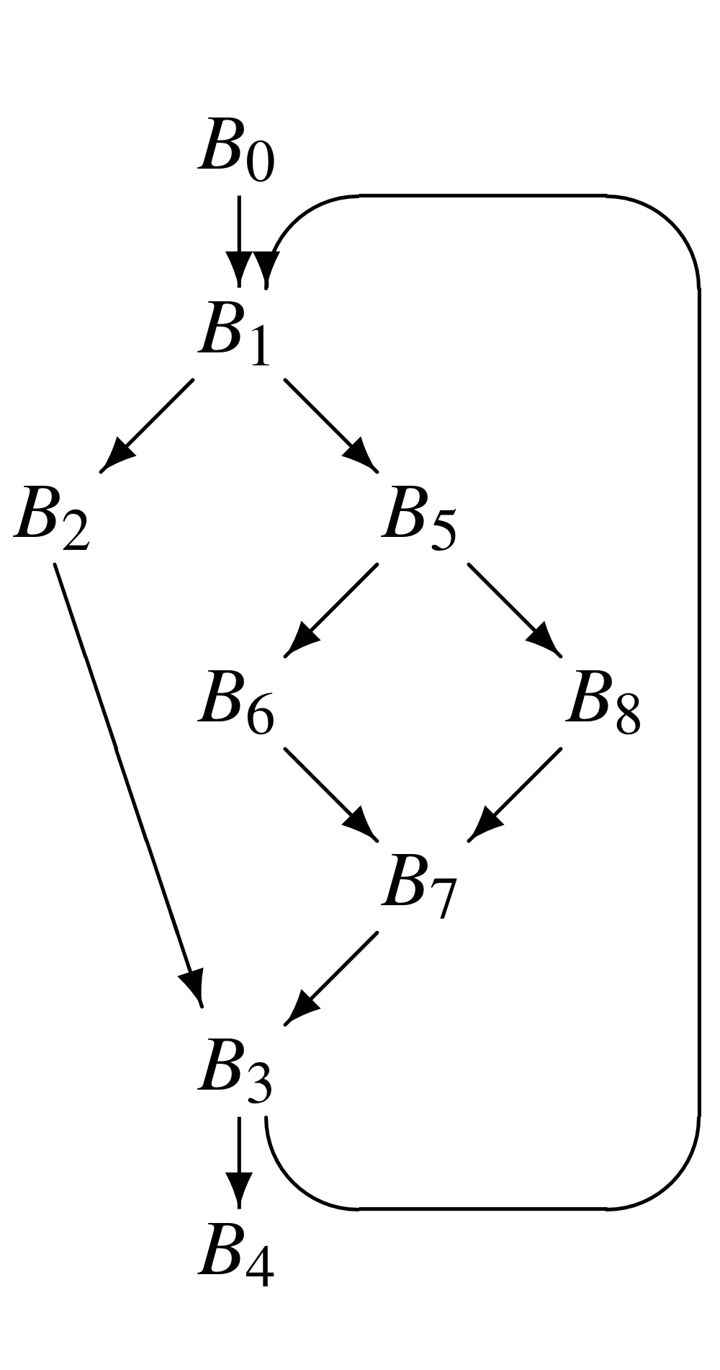
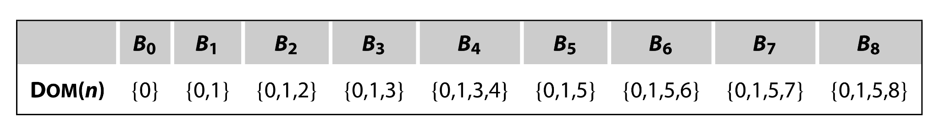
Another Data-flow Problem: Dominance
Definition
In a CFG with entry block b0, node bi dominates node bj iff bi lies on every path from b0 to bj.

Slide 48
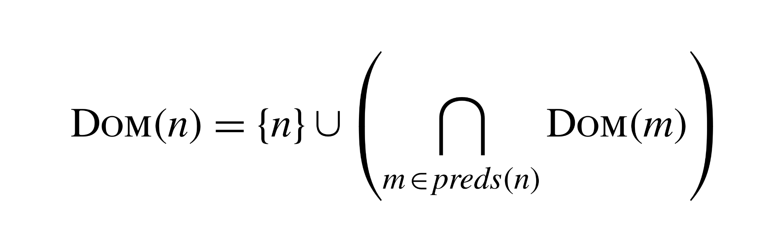
Data-flow Equation of Dominance
A block i dominates another block j iff block i dominates all of the predecessors of block j.
DOM(n): The set of blocks that dominate block n

Slide 49
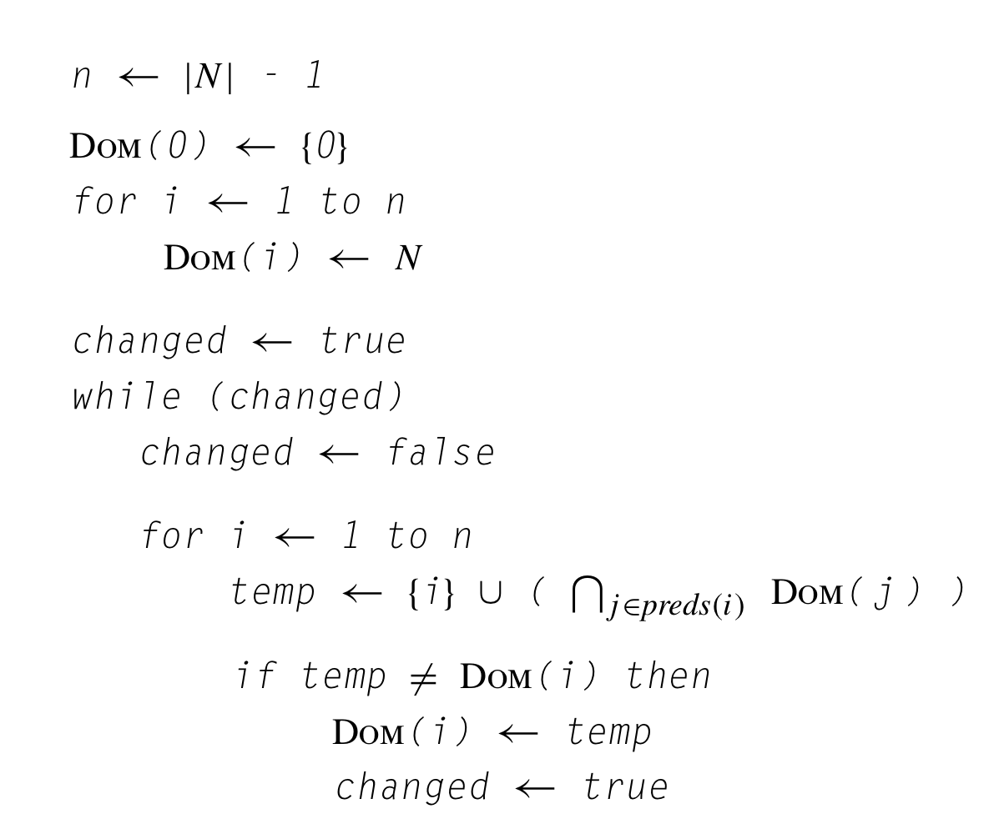
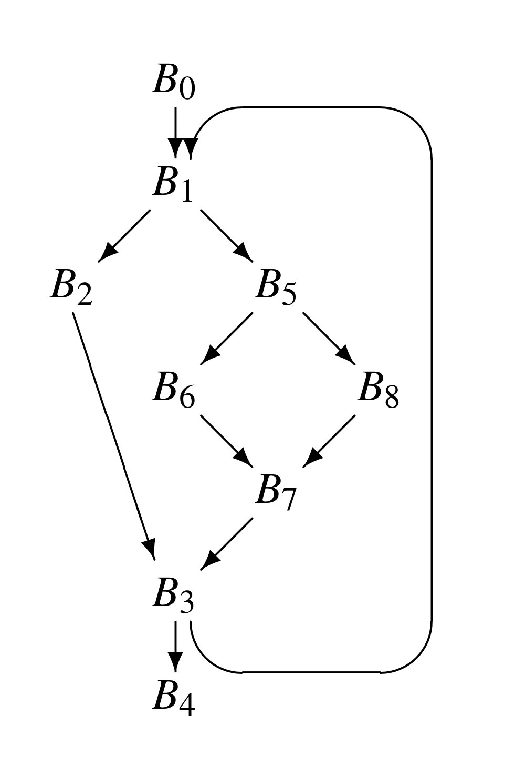
Iterative Solver for Dominance

Slide 50
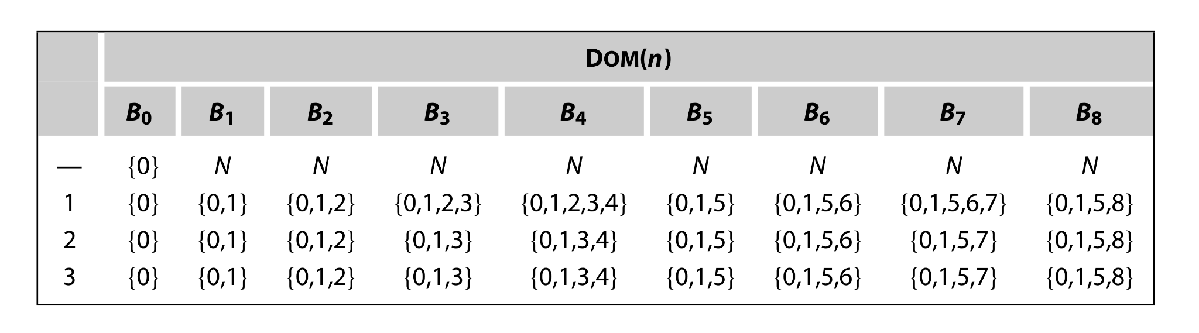
Iterative Solver for Dominance
Evaluate the nodes in order by their CFG name:
B0, B1, B2, B3, B4, B5, B6, B7, B8
N : the set of all nodes in the CFG

Slide 51
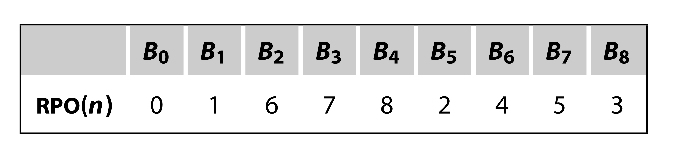
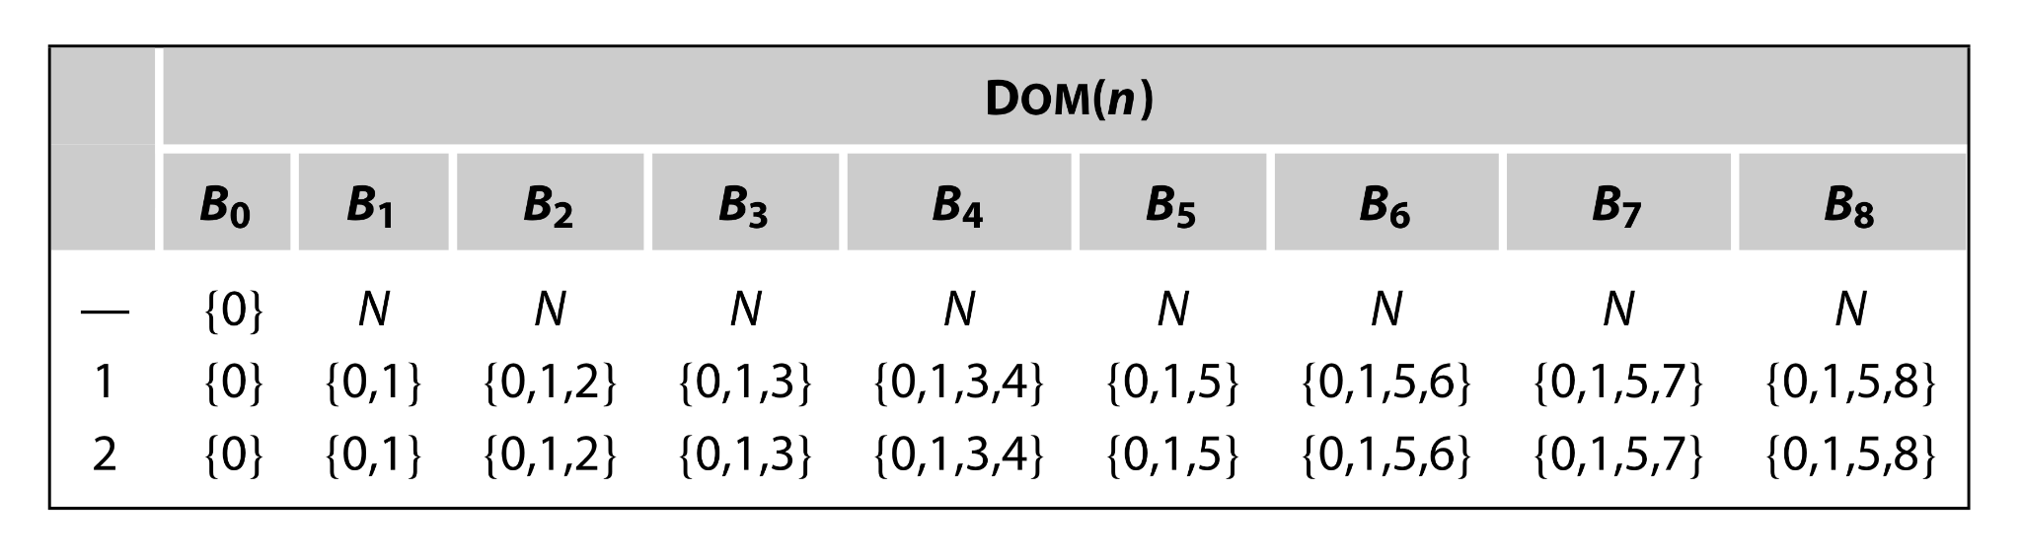
Reverse Postorder in Forward Data-flow Problem

Slide 52
References
Engineering A Compiler (2nd. ed.).
Compilers: Principles, Techniques, and Tools (2nd. ed.).
Static Program Analysis
CS 6120: Advanced Compilers Lessons
CS243: Program Analysis and Optimizations

Slide 53
Framework of Solving the Data-flow Problem
We can characterize both of these analyses within a common framework.
The data-flow analysis framework has four components:
The direction of analysis (forward or backward)
The values being propagated
Transfer functions for each of the nodes
A meet operator
Notes:
ref

Slide 54
Data-flow Values
A key component of data-flow analysis framework is the set of values that the analysis is computing on.
In live variable analysis, the values were sets of variables.
In dominance analysis, the values were sets of labels of basic blocks.

Slide 55
Data-flow Values
Program point: points in between the execution of nodes; at the beginning and end of each node.
Let L be the set of all values that can be assigned to a program point. We will use l to denote a single value contained in L.
Data-flow values represent some proposition that must hold at the program point they are attached to.
In the live variable analysis, the meaning of the set of variables attached to a program point is all the variables in the set must be live at the point.

Slide 56
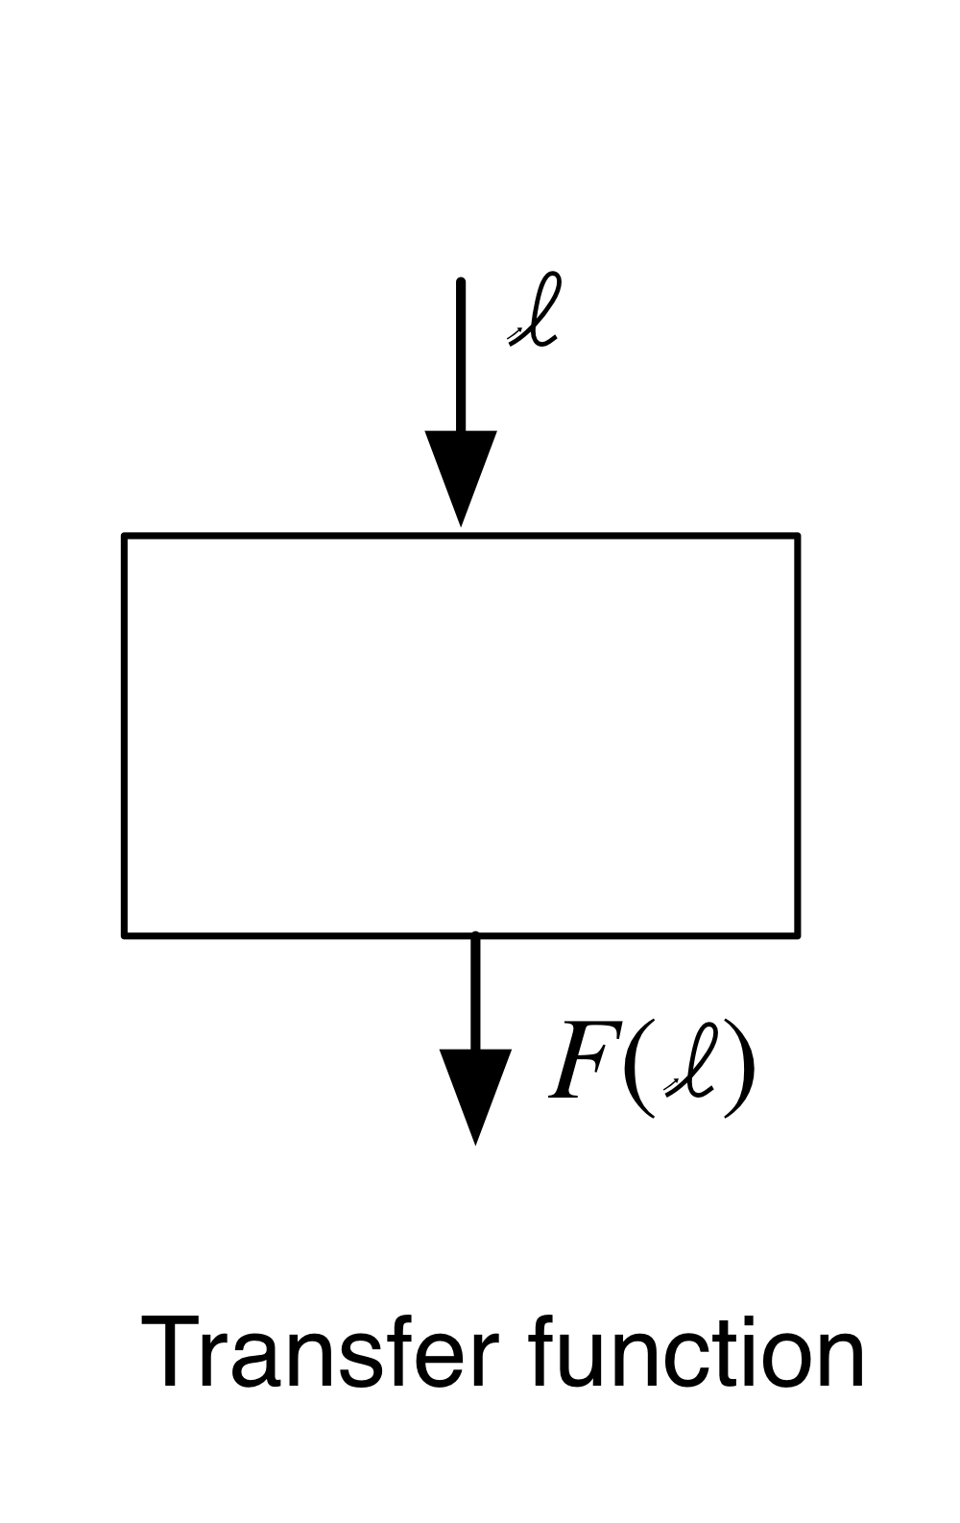
Transfer Functions
The second part of the data-flow analysis is a set of transfer functions.
The set of transfer functions describe how data-flow values are transformed by a node.

Slide 57
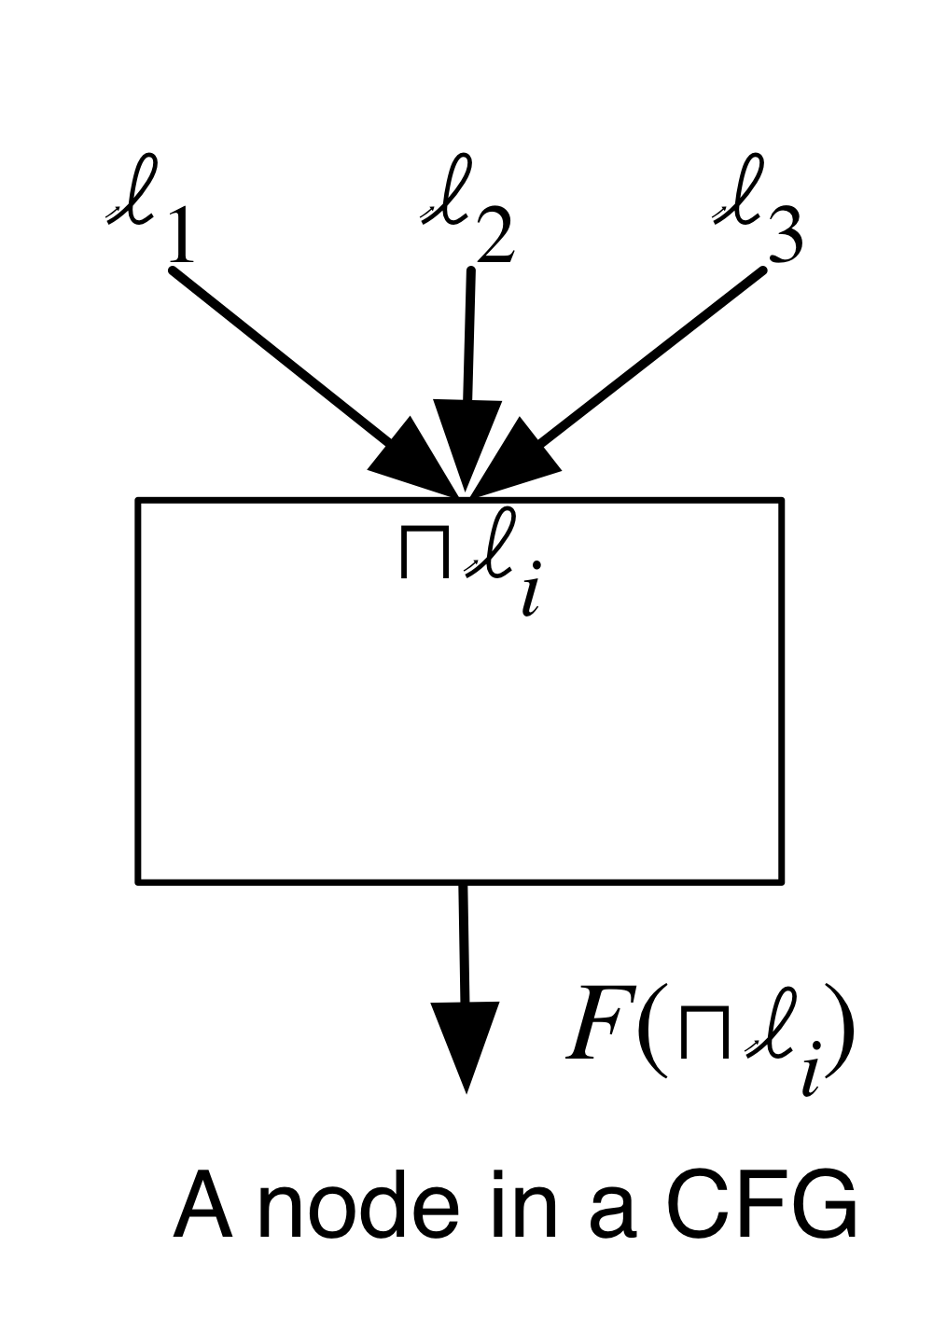
Meet Operator
The final part of the data-flow analysis which defines how to combine values from multiple incoming edges.
Supposing we have propositions corresponding to l1, l2, and l3 on various edges.

Slide 58
Meet Operator
For the live variable analysis, the meet operator is union.
For the dominance analysis, the meet operator is intersection.

Slide 59
Why Deriving the Data-flow Analysis Framework?
We derive the data-flow analysis (DFA) framework to ensure the finite descending chain properties by the lattice theory.
In a lattice, the meet operator is monotone, meaning the number of values after meet either stays the same or goes only in one direction.
The two properties of a monotone transfer function complete DFA
Closed under composition: composition of monotone transfer function is still monotone transfer function.
Fixed point: f(x) = x.
Notes:
the direction is either increasing or decreasing—depending on the meet’s partial order.

Slide 60
How to Derive the Data-flow Analysis Framework?
Figure out the data-flow values and their abstract values at the entry and exit of each program point.
Write an equation for every program point relating the values at the entry to that thing at the exit.
Generate equalities according to the edges in the CFG or instruction depending on the program points.
Solve the system of equations.
Notes:
the direction is either increasing or decreasing—depending on the meet’s partial order.

Slide 61
Identify the Abstract Values
The abstract values are properties we want to know about at program points.
The set of abstract values and some binary relation should form a lattice.
Notes:
the direction is either increasing or decreasing—depending on the meet’s partial order.

Slide 62
Partial Order
To define lattices, we define the partial order (S, ⊑) first.
A partial order is a set S of a binary relation ⊑ with the three conditions
Reflexivity: ∀x ∈ S : x ⊑ x
Transitivity: ∀x, y, z ∈ S : x ⊑ y ∧ y ⊑ z =⇒ x ⊑ z
Anti-symmetry: ∀x, y ∈ S : x ⊑ y ∧ y ⊑ x =⇒ x = y

Slide 63
Least Upper Bound & Greatest Lower Bound
Let’s consider the bounds of subset X ⊆ S.
y ∈ S is a upper bound X ⊑ y, where ∀x ∈ X : x ⊑ y.
A least upper bound lub(X) ∈ S is defined as
X ⊑ lub(X) ∧ ∀y ∈ S : X ⊑ y ⇒ lub(X) ⊑ y
If X has only two elements {x, y}, we sometimes use infix notation x ⊔ y .
Similarly, glb(X) is greatest lower bound of subset X and x ⊓ y is the glb({x, y}).

Slide 64
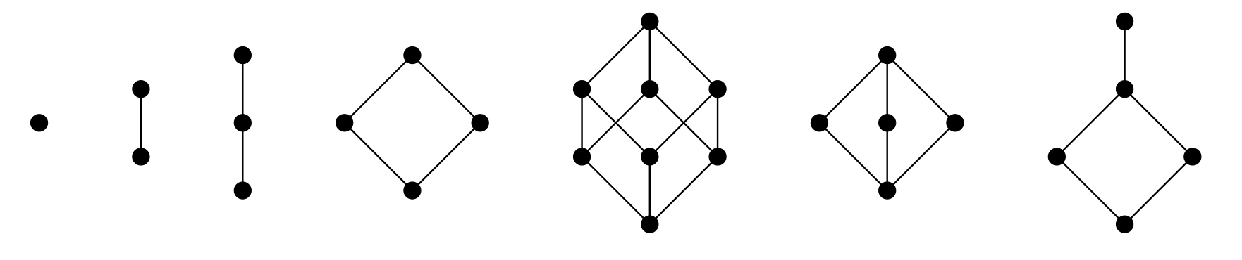
Lattice
Lattice: A partial order (S, ⊑) where x ⊔ y and x ⊓ y exist for all x, y ∈ S.
Complete lattice: A lattice where lub(X) and glb(X) exist for all X ⊆ S.
These partial orders are lattices:
Notes:
Complete lattice: A lattice where glb(X) and lub(X) exist for all X ⊆ S.
Every finite lattice is complete lattice

Slide 65

Lattice
These partial orders are NOT lattices:

Slide 66
Motivating Example: Sign Analysis
For example, when we want to design an analysis that can find out the possible signs of the integer values of variables and expressions in a given program.
We can define the types of the signs into an set S = {+, -, 0, ⊤, ⊥}, where ⊤ is values with arbitrary sign, ⊥ is not integer.
Notes:
the direction is either increasing or decreasing—depending on the meet’s partial order.

Slide 67
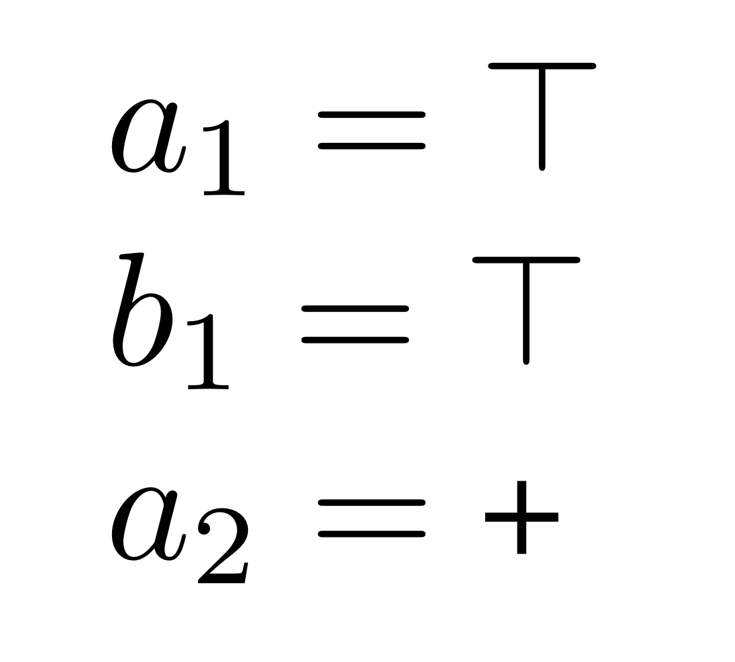
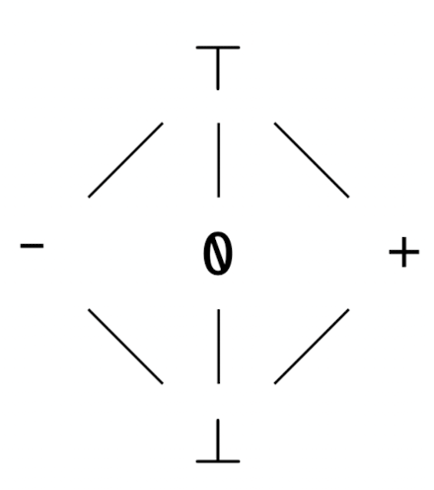
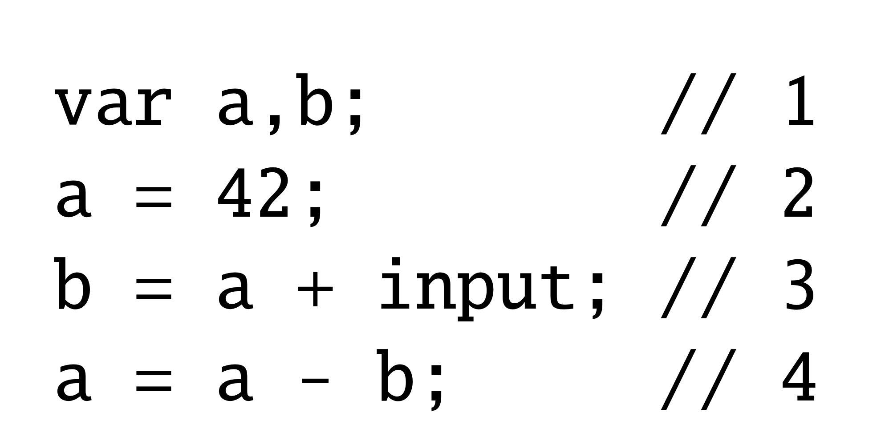
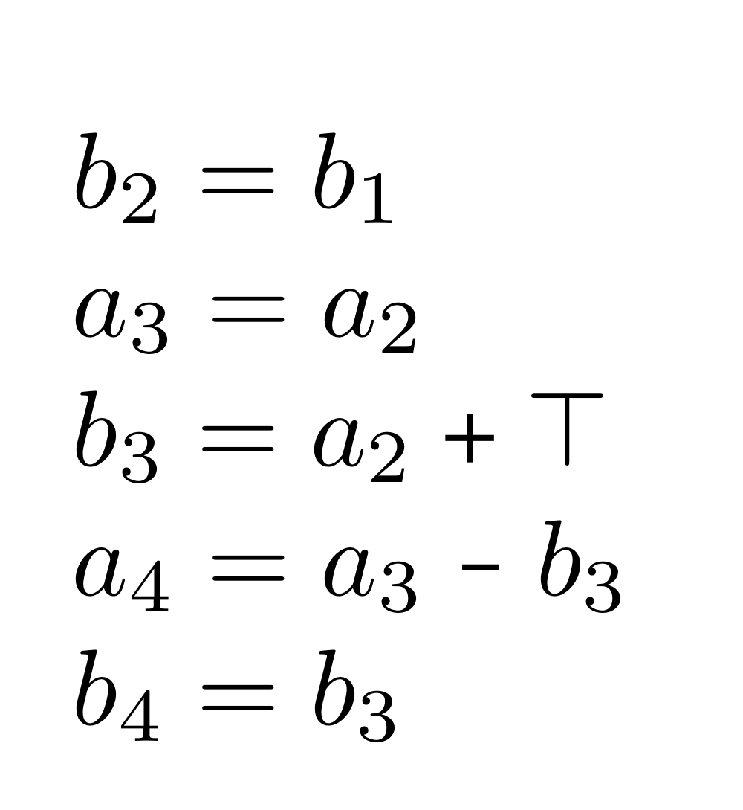
Motivating Example: Sign Analysis
We can define the binary operation ⊑ as:
x ⊑ y: x is at least as precise as y
The set of abstract values S = {+, -, 0, ⊤, ⊥} and the binary operation ⊑ form a lattice as shown below:
Notes:
the direction is either increasing or decreasing—depending on the meet’s partial order.

Slide 68
Constructing Lattices
We know what a lattice L of a set of abstract values is, but what is the lattice of data-flow anaylsis?
To define the lattice of data-flow anaylsis, we need to maps the set of data-flow values to the lattice of abstract values.
We can construct the map lattice A → L defined as follows:
A → L = {[a1→x1,a2→x2,...] | A={a1,a2,...} ∧ x1,x2,...∈L}, where A is the set of data-flow values, a→x means the function that maps a to x.
f ⊑ g ⇔ ∀a ∈ A : f(a) ⊑ g(a) where f, g ∈ A → L.
Notes:
Do not consider 0 + positive integer is positive integer, instead, the union of {0} and positive integer is contained in ⊤.

Slide 69
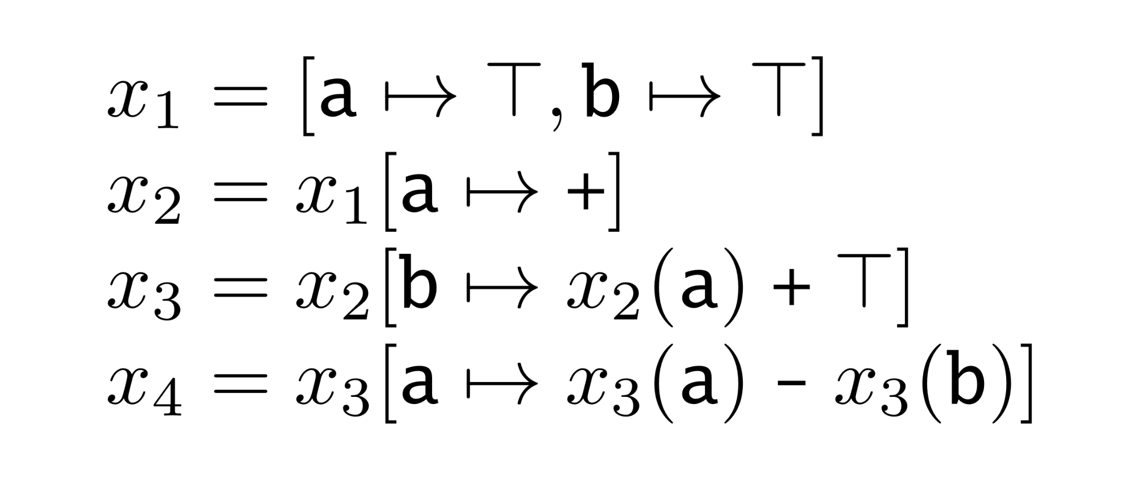
Constructing Lattices
An example of constructing the map Lattice:
Notes:
Do not consider 0 + positive integer is positive integer, instead, the union of {0} and positive integer is contained in ⊤.

Slide 70
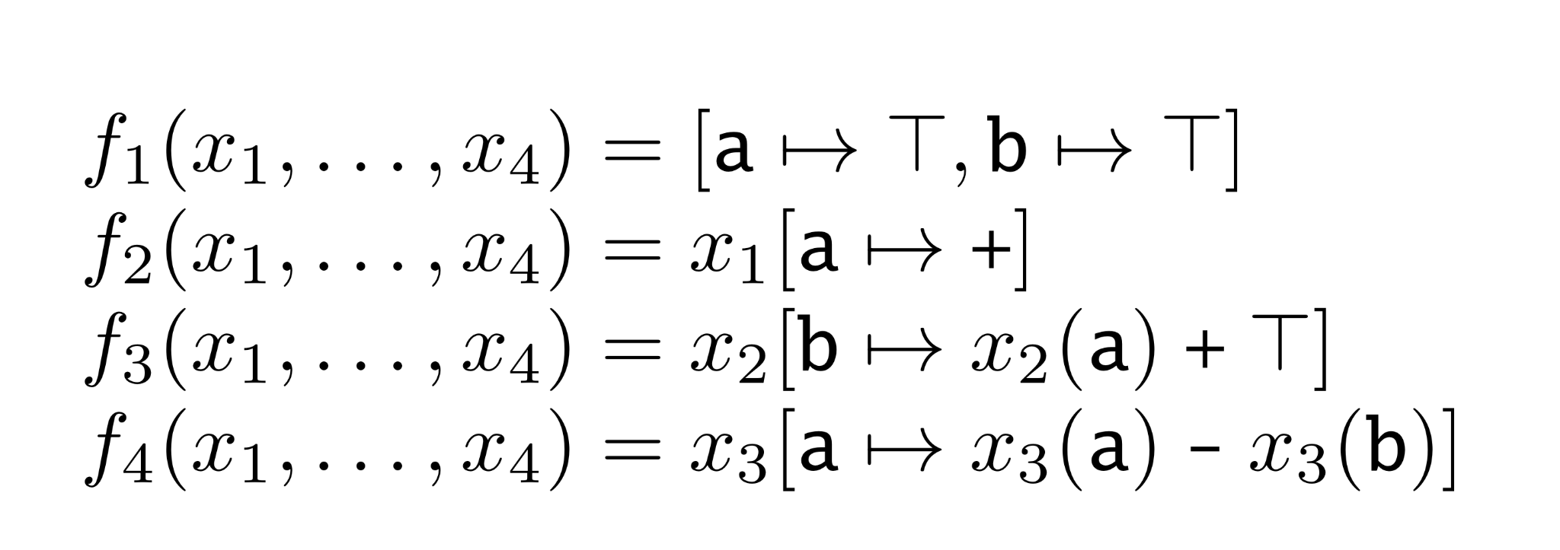
Equation System over Constraint Functions

Slide 71
Solution of the Equation System
A solution to an equation system provides a value from L for each variable such that all equations are satisfied.
There may be multiple solutions to a set of equations
All solutions to the equations are considered safe, but maybe imprecise

Slide 72
Monotone Property on Constraint Functions
Monotone: constraint funcion maps the current map lattice L1 to the new map lattice L2, where L1 and L2 maps data-flow values to abstract values.
A function f : L1 → L2 where L1 and L2 are lattices is monotone (or order-preserving) when ∀x, y ∈ L1 : x ⊑ y ⇒ f(x) ⊑ f(y).
In program analysis, the intuition of monotonicity is that “more precise input does not result in less precise output.”

Slide 73
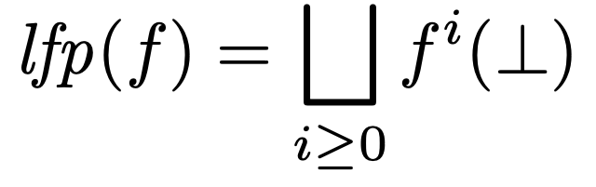
Fixed-point Theorem
Fixed-point: x ∈ L is a fixed point for function f if f(x) = x.
Fixed-point Theorem:
In a complete lattice L with finite height, every monotone function f : L → L has a unique least fixed point denoted lfp(f) defined as:
Sketch of Proof:
Observe that the increasing chain: ⊥ ⊑ f(⊥) ⊑ f²(⊥) ⊑ …
Since L is assumed to have finite height, we must have fixed point f^{k}(⊥) = f^{k+1}(⊥) = lfp(f).
Assume now that x is another fixed point that f(x) = x. Since ⊥ ⊑ x and f is monotone, it follows that f(⊥) ⊑ f(x) = x, by induction we get lfp(f) = f^{k}(⊥) ⊑ x.
If x is also the lfp(f), similarly, x ⊑ f^{k}(⊥). By anti-symmetric, x = f^{k}(⊥) is unique.

Slide 74
Fixed-point Theorem
Suppose the lattices have finite height and the constraint functions are monotone
Fixed-point Theorem tells us:
The equation systems over complete lattices always have solutions
Uniquely most precise solutions always exist
We can simply compute the increasing chain until the fixed point is reached

Slide 75
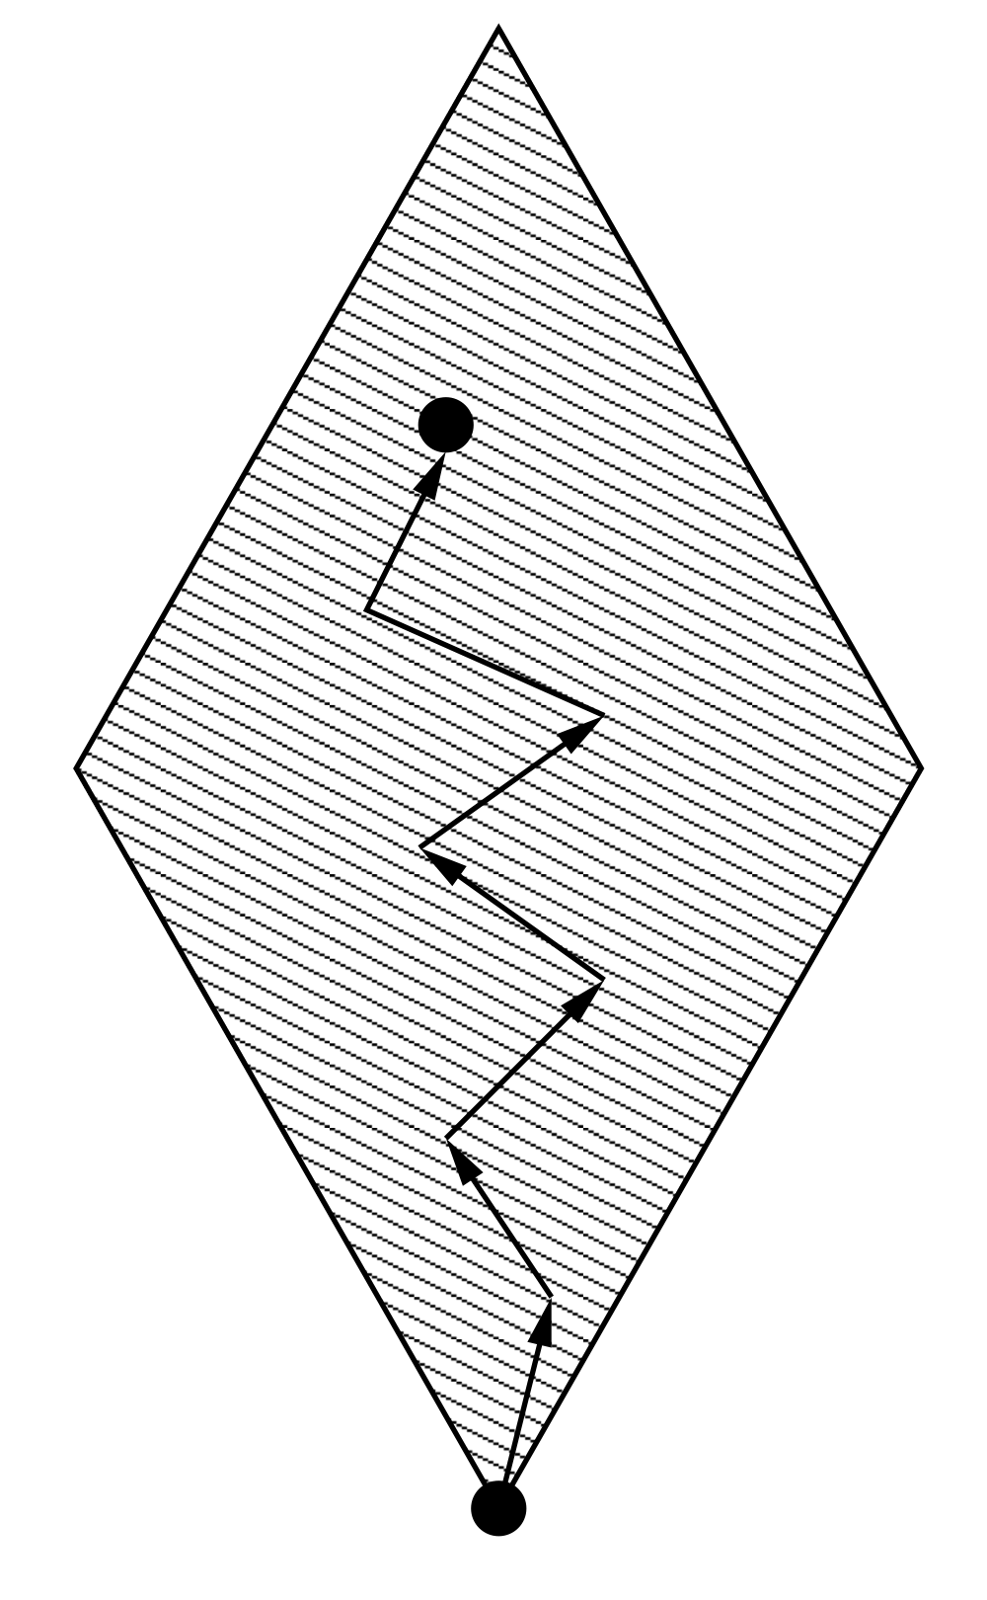
Iterative Algorithm From Fixed-point Theorem

Slide 76
References
Engineering A Compiler (2nd. ed.).
Compilers: Principles, Techniques, and Tools (2nd. ed.).
Static Program Analysis
CS 6120: Advanced Compilers Lessons
CS243: Program Analysis and Optimizations

